Slide 2
Definition
Measures of dispersion are descriptive statistics that describe how similar a set of scores are to each other
The more similar the scores are to each other, the lower the measure of dispersion will be
The less similar the scores are to each other, the higher the measure of dispersion will be
In general, the more spread out a distribution is, the larger the measure of dispersion will be

Slide 3
Measures of Dispersion
There are three main measures of dispersion:
The range
The Interquartile range
The semi-interquartile range (SIR)-(Quartile Deviation)
Variance
Standard deviation

Slide 4
The Range
The range is defined as the difference between the largest score in the set of data and the smallest score in the set of data, X_{L} - X_{S}
What is the range of the following data: 4 8 1 6 6 2 9 3 6 9
The largest score (X_{L}) is 9; the smallest score (X_{S}) is 1; the range is X_{L} - X_{S} = 9 - 1 = 8

Slide 5
When To Use the Range
The range is used when
you have ordinal data or
you are presenting your results to people with little or no knowledge of statistics
The range is rarely used in scientific work as it is fairly insensitive
It depends on only two scores in the set of data, X_{L} and X_{S}
Two very different sets of data can have the same range: 1 1 1 1 9 vs 1 3 5 7 9

Slide 6
Calculating Quartiles
Every data set has three quartiles, which divide it into four equal parts
If the horizontal line can be thought of as a data set arranged in an ordered array, three quartiles can be identified, which together produce four separate parts or subset of equal size in the data set.
Subset 1
Subset 2
Subset 3
Subset 4
Q₁
Q₂
Q₃

Slide 7
First Quartile – Grouped data
The first quartile is the value below which, at most, 25% of the observations fall, and above which the remaining 75% can be found
where
L=lower limit of the class containing Q₁,
CF= cumulative frequency preceding class containing Q₁,
f= frequency of class containing Q₁,
i= size of class containing Q₁.

Slide 8
Second Quartile – Grouped data
The second quartile is right in the middle. Same as the median

Slide 9
Third Quartile – Grouped data
The third quartile is the value below which, at most, 75% of the observations fall, and above which the remaining 25% can be found
where
L=lower limit of the class containing Q₃,
CF= cumulative frequency preceding class containing Q₃,
f= frequency of class containing Q₃,
i= size of class containing Q₃.

Slide 10
Inter-quartile Range
The Interquartile range is the distance between the third quartile Q3 and the first quartile Q1.
Inter-quartile range = third quartile - first quartile
= Q3 - Q1

Slide 11
Example
Find the Inter quartile range
Class Boundary | Frequency
350-360 | 4
360-370 | 6
370-380 | 5
380-390 | 4
390-400 | 3

Slide 12
The Semi-Interquartile Range -(Quartile Deviation)
The semi-interquartile range (or SIR) is defined as the difference of the first and third quartiles divided by two
The first quartile is the 25th percentile
The third quartile is the 75th percentile
SIR = (Q₃ - Q₁) / 2

Slide 13
SIR Example
What is the SIR for the data to the right?
25 % of the scores are below 5
5 is the first quartile
25 % of the scores are above 25
25 is the third quartile
SIR = (Q₃ - Q₁) / 2 = (25 - 5) / 2 = 10

Slide 14
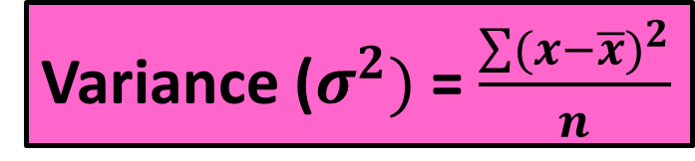
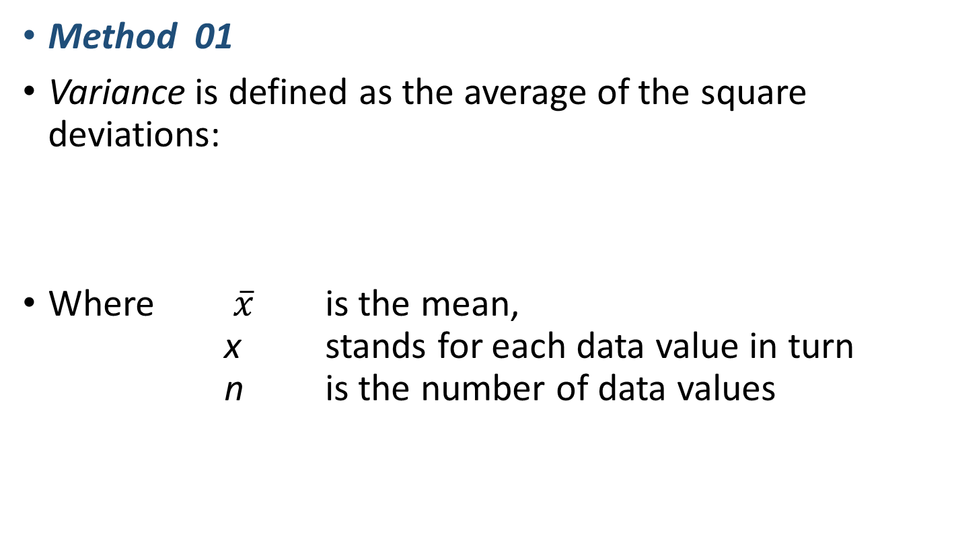

Variance and Standard Deviation – Ungroup Data
Method 01
Variance is defined as the average of the square deviations:
Where $\overline{x}$ is the mean, x stands for each data value in turn n is the number of data values
Variance ($σ^{2})$ = $\frac{\sum{(}x−\overline{x})^{2}}{n}$
Standard Deviation ($σ$) = $\sqrt{\frac{\sum{(}x−\overline{x})^{2}}{n}}$ =$\sqrt{\text{Variance}}$

Slide 15
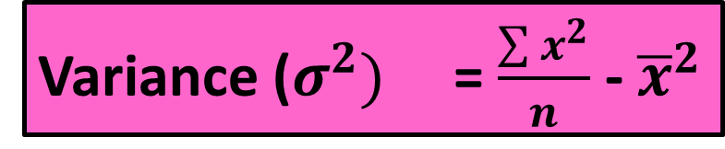


Variance and Standard Deviation – Group Data
Method 02
Variance is defined as the average of the square deviations:
Where $\overline{x}$ is the mean, x stands for each data value in turn n is the number of data values
Variance ($σ^{2})$ = $\frac{\sum{x^{2}}}{n}$ - ${\overline{x}}^{2}$
Standard Deviation ($σ$) = $\sqrt{\frac{\sum{x^{2}}}{n}\text{ - }{\overline{x}}^{2}}$ =$\sqrt{\text{Variance}}$

Slide 16
Example
Find the variance and Standard Deviation of 6, 7, 10, 11, 11, 13, 16, 18, 25.

Slide 17
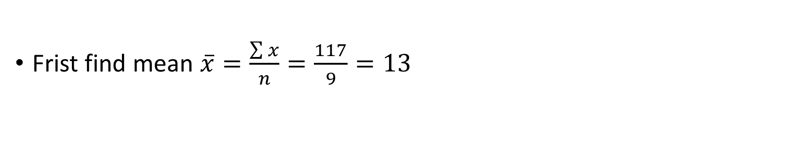
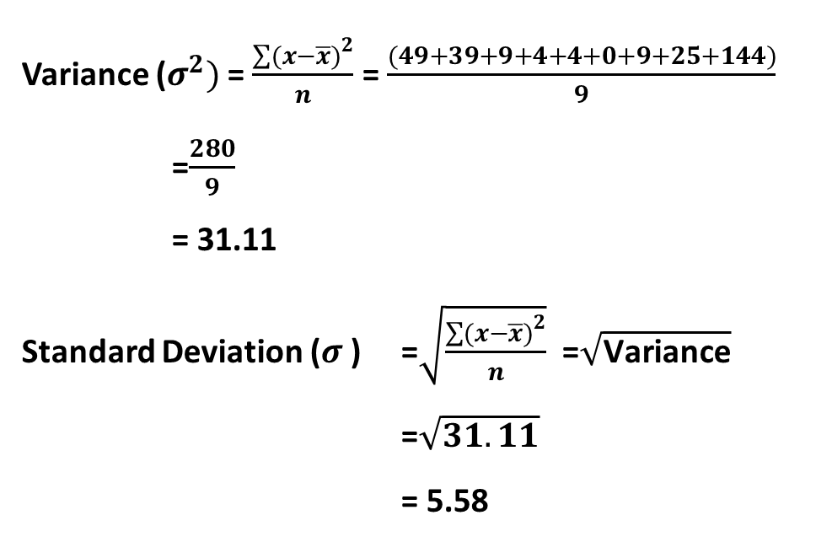




Method 01----Using [ $σ^{2}$ = $\frac{\sum{(}x−\overline{x})^{2}}{n}$ ]
Frist find mean $\overline{x}=\frac{\sum{x}}{n}=\frac{117}{9}=13$
Variance ($σ^{2})$ = $\frac{\sum{(}x−\overline{x})^{2}}{n}$ = $\frac{(49+39+9+4+4+0+9+25+144)}{9}$
=$\frac{280}{9}$
= 31.11
Standard Deviation ($σ$) =$\sqrt{\frac{\sum{(}x−\overline{x})^{2}}{n}}$ =$\sqrt{\text{Variance}}$
=$\sqrt{31.11}$
= 5.58
 | Mean =13
6 |  | -7 | 49
7 |  | -6 | 36
10 |  | -3 | 9
11 |  | -2 | 4
11 |  | -2 | 4
13 |  | 0 | 0
16 |  | 3 | 9
18 |  | 5 | 25
25 |  | 12 | 144
$$x$$
$$x−\overline{x}$$
$$(x−\overline{x})^{2}$$

Slide 18

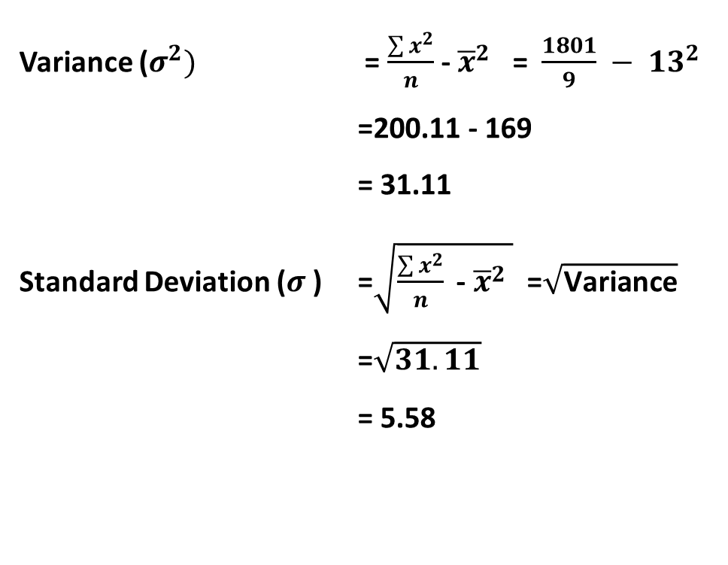


Method 02----Using [ $σ^{2}$ =$\frac{\sum{x^{2}}}{n}$ - ${\overline{x}}^{2}$ ]
Frist find mean $\overline{x}=\frac{\sum{x}}{n}=\frac{117}{9}=13$
6 | 36
7 | 49
10 | 100
11 | 121
11 | 121
13 | 169
16 | 256
18 | 324
25 | 625
117 | 1801
Variance ($σ^{2})$ = $\frac{\sum{x^{2}}}{n}$ - ${\overline{x}}^{2}$ = $\frac{1801}{9} − {13}^{2}$
=200.11 - 169
= 31.11
Standard Deviation ($σ$) =$\sqrt{\frac{\sum{x^{2}}}{n}\text{ - }{\overline{x}}^{2} }$ =$\sqrt{\text{Variance}}$
=$\sqrt{31.11}$
= 5.58
$$x$$
$$x^{2}$$
Total

Slide 19
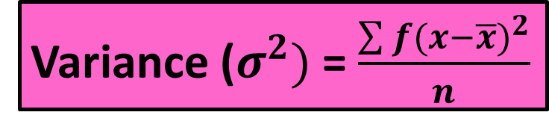

Variance and Standard Deviation – Group Data
Method 01
Variance is defined as the average of the square deviations:
Where $\overline{x}$ is the mean, x stands for each data value in turn n is the number of data values
Variance ($σ^{2})$ = $\frac{\sum{f(}x−\overline{x})^{2}}{n}$
Standard Deviation ($σ$) = $\sqrt{\frac{\sum{f(}x−\overline{x})^{2}}{n}}$ =$\sqrt{\text{Variance}}$

Slide 20
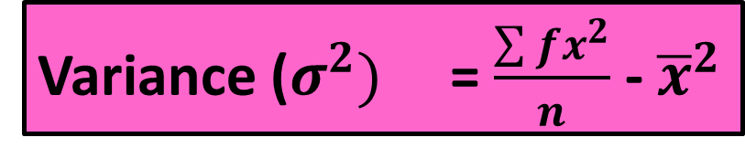


Variance and Standard Deviation – Group Data
Method 02
Variance is defined as the average of the square deviations:
Where $\overline{x}$ is the mean, $\overline{x}=\frac{\sum{fx}}{n}$ x stands for each data value in turn n is the number of data values
Variance ($σ^{2})$ = $\frac{\sum{{fx}^{2}}}{n}$ - ${\overline{x}}^{2}$
Standard Deviation ($σ$) = $\sqrt{\frac{\sum{{fx}^{2}}}{n}\text{ - }{\overline{x}}^{2}}$ =$\sqrt{\text{Variance}}$

Slide 21
Example
Find an estimate of the variance and standard deviation of the following data for the marks obtained in a test by 88 students
Marks | Frequency (f)
0 ≤ x < 10 | 6
10 ≤ x < 20 | 16
20 ≤ x < 30 | 24
30 ≤ x < 40 | 25
40 ≤ x < 50 | 17
Total | ??

Slide 22
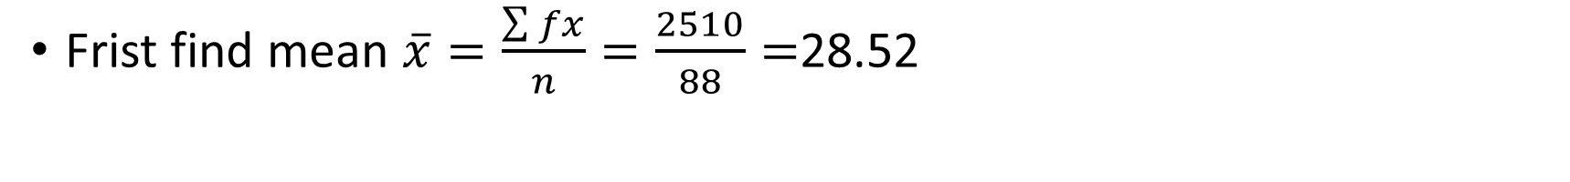

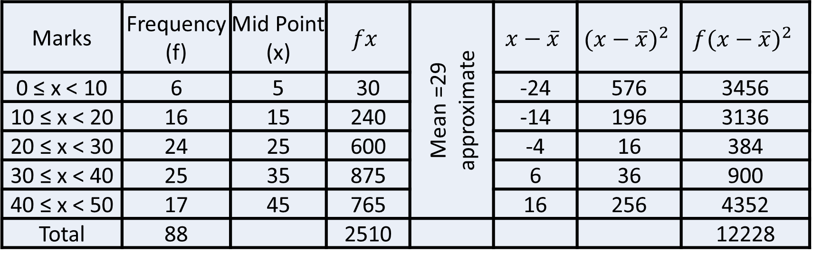
Method 01----Using [ $σ^{2}$ = $\frac{\sum{f(}x−\overline{x})^{2}}{n}$ ]
Frist find mean $\overline{x}=\frac{\sum{fx}}{n}=\frac{2510}{88}=$28.52
Marks | Frequency (f) | Mid Point (x) | $$fx$$ | Mean =29 approximate | $$x−\overline{x}$$ | $${(x−\overline{x})}^{2}$$ | $${f(x−\overline{x})}^{2}$$
0 ≤ x < 10 | 6 | 5 | 30 |  | -24 | 576 | 3456
10 ≤ x < 20 | 16 | 15 | 240 |  | -14 | 196 | 3136
20 ≤ x < 30 | 24 | 25 | 600 |  | -4 | 16 | 384
30 ≤ x < 40 | 25 | 35 | 875 |  | 6 | 36 | 900
40 ≤ x < 50 | 17 | 45 | 765 |  | 16 | 256 | 4352
Total | 88 |  | 2510 |  |  |  | 12228

Slide 23
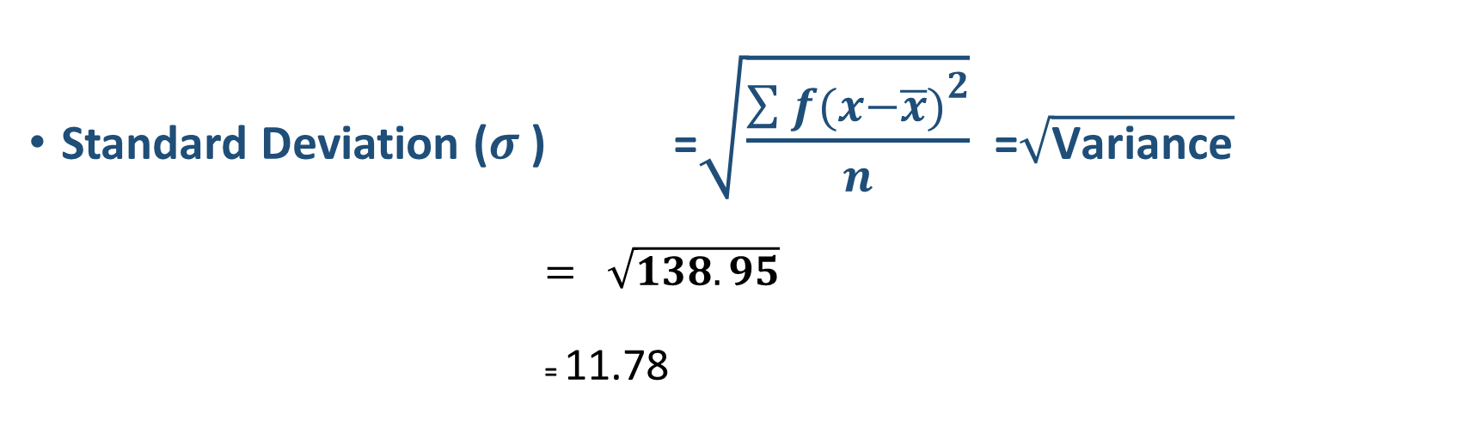
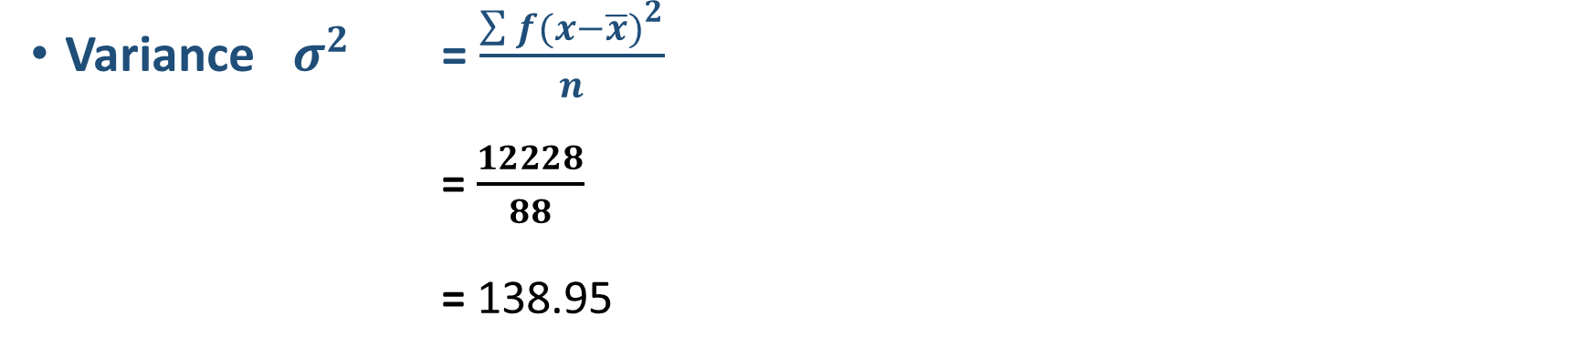
Variance $σ^{2}$ = $\frac{\sum{f(}x−\overline{x})^{2}}{n}$
= $\frac{12228}{88}$
= 138.95
Standard Deviation ($σ$) =$\sqrt{\frac{\sum{f(}x−\overline{x})^{2}}{n}}$ =$\sqrt{\text{Variance}}$
$= \sqrt{138.95}$
= 11.78

Slide 24

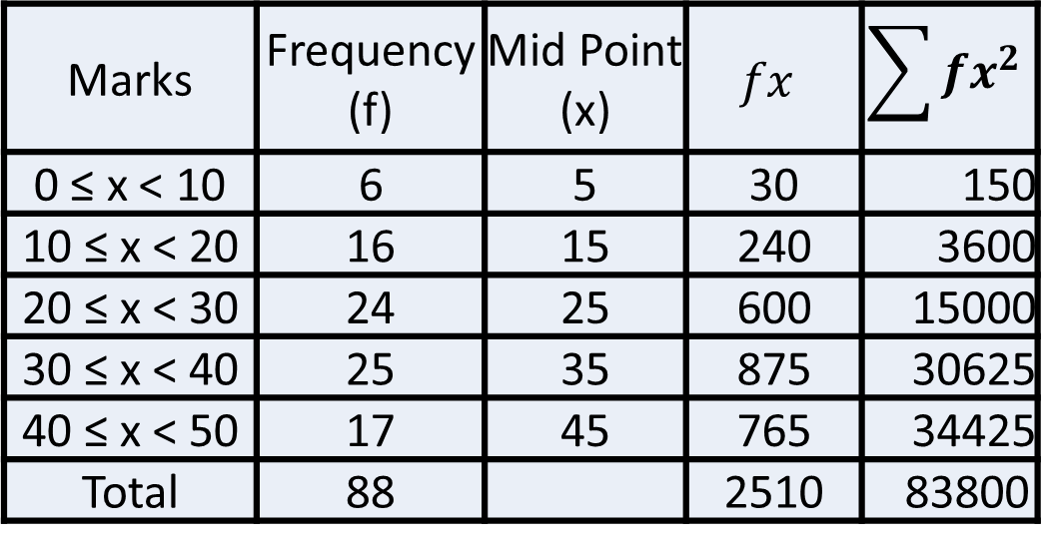
Method 02----Using [ $σ^{2}$ =$\frac{\sum{fx^{2}}}{n}$ - ${\overline{x}}^{2}$ ]
Frist find mean $\overline{x}=\frac{\sum{fx}}{n}=\frac{2510}{88}=$28.52
Marks | Frequency (f) | Mid Point (x) | $$fx$$ | $$\sum{fx^{2}}$$
0 ≤ x < 10 | 6 | 5 | 30 | 150
10 ≤ x < 20 | 16 | 15 | 240 | 3600
20 ≤ x < 30 | 24 | 25 | 600 | 15000
30 ≤ x < 40 | 25 | 35 | 875 | 30625
40 ≤ x < 50 | 17 | 45 | 765 | 34425
Total | 88 |  | 2510 | 83800

Slide 25
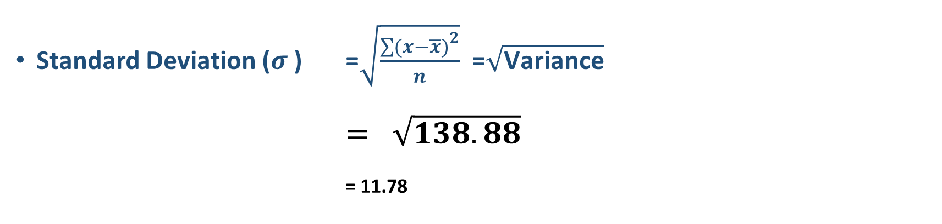
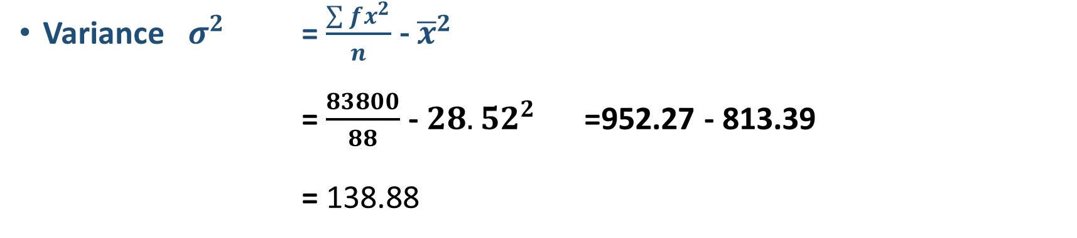
Variance $σ^{2}$ =$\frac{\sum{fx^{2}}}{n}$ - ${\overline{x}}^{2}$
= $\frac{83800}{88}$ -${ 28.52}^{2}$ =952.27 - 813.39
= 138.88
Standard Deviation ($σ$) =$\sqrt{\frac{\sum{(}x−\overline{x})^{2}}{n}}$ =$\sqrt{\text{Variance}}$
$= \sqrt{138.88}$
= 11.78

